Slide 1


PPP Fraud & DI Claims
Virtual Meeting: Thursday, May 18, 2023
Speakers: Ernest Patrick Smith &
John Hoffman

Slide 2

Ernest Patrick Smith, CPA/CFF/ABV, CVA, CFE, is a graduate of Hofstra University. He is a Certified Public Accountant and a Certified Fraud Examiner. Mr. Smith began his career with the Long Island Office of one of the world’s largest public accounting firms. He has diversified experience in financial statement preparation, taxation, tax planning, internal auditing, investigative accounting, measurement of damages and litigation support services, with emphasis in matters dealing with business valuation, fidelity losses and fraud. He has extensive experience in succession planning and other estate, trust and tax planning services that pertain to the operations of small to medium sized companies.
John K. Hoffman, CPA/CFF/CITP
Partner with Nawrocki Smith LLP leading the Insurance Claims Consulting Group. He joined the firm of Nawrocki Smith in 1995 and provides insurance consulting, forensic accounting services, litigation support and risk management services. He has been recognized as an expert witness in disability-related litigation in both federal and state courts.

Slide 3
Definition of Fraud (Many Definitions)
Under common law
Three elements are required to prove fraud: a material false statement made with an intent to deceive, a victim’s reliance on the statement and damages.
Another frequent used definition
Knowingly lie with the intent to deceive someone, someone relies on the lie and fraudster receives a benefit.
Notes:
3 elements needed in my opinion
1- knowingly lie with intent to deceive
2- someone relies on the lie
3- a benefit is received

Slide 4
California Department of Insurance (Hardest Place of Earth to Prove Fraud)
Fraud occurs when someone knowingly lies to obtain a benefit or advantage to which they are not otherwise entitled or someone knowingly denies a benefit that is due and to which someone is entitled. According to the law, the crime of insurance fraud can be prosecuted when:
The suspect had the intent to defraud. Insurance fraud is a "specific" intent crime. This means a prosecutor must prove that the person involved knowingly committed an act to defraud.
An act is completed. Simply making a misrepresentation (written or oral) to an insurer with knowledge that is untrue is sufficient.
The act and intent must come together. One without the other is not a crime.
Actual monetary loss is not necessary as long as the suspect has committed an act and had the intent to commit the crime.
Notes:
‘OR’ someone knowingly denies a benefit that is due to someone entitled to it. (any attorneys in the room that want to comment)
The act & intent must come together. One without the other is not a crime (this is another thing to the attorneys to argue about)

Slide 5
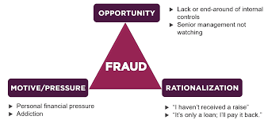
Fraud Triangle
Notes:
Fraud triangle (Donald Cressey) CFE
Donald Cressey - Wikipedia
Donald Ray Cressey (April 27, 1919 – July 21, 1987) was an American penologist, sociologist, and criminologist who made innovative contributions to the study of organized crime, prisons, criminology, the sociology of criminal law, white-collar crime.
OPPORTUNITY (CERTAINLY ASSISTED DURING COVID WITH PPP LOANS),
2) Pressure
3) Rationalization

Slide 6
What is a PPP Loan?
SBA Loans issued to businesses during Covid-19 to keep their employees on the payroll.
Application Process
Forgiveness Process
Determined Not to be Taxable
Approximately $800 Billion of PPP Loans Issued (Program ended May 31, 2021)
As of Jan. 9, 2023, approximately 92% of loans granted full or partial forgiveness.
Who received the money?
SBA Paycheck Protection Program Data Lookup - FederalPay https://www.federalpay.org/paycheck-protection-program
(Use less search words to get best results)
Notes:
Paycheck Protection Program
Approx. $800 to $900 Billion in loans
Set up for small business (less than 500 employees) SBA loans… 1% interest rate, no collateral needed, no personal guarantee
Very different from the bank climate today. Fed increasing rates & Failure of SVB & Signature Bank lead to a very tough lending environment. 6-7% interest rates, usage fees for business lines of credit, banks reducing or decreasing loc and all when money is needed most by small business leading into a recession.
application – 2.5 times average monthly payroll, max. loan $10M (round 1 - $349B started on 4/3/2020 ended 4/16/2020 funds gone for round 1) (Round 2 max loan $2M – $300+ Billion)
Program was easy to use and access
Everyone was approved-the underwriting was nearly non-existent
The forgiveness process, at the outset, seemed as if it would be difficult but that was reduced when just after the process commenced they reduced the requirement for borrowers to “prove their need for the loan” thus making any “half-decent application” for a loan legit
Approx 92% of loans forgiven as of 1/9/2023
Determined to be NON-taxable after some back and forth with the IRS and congress
PPP look up

Slide 7
What is PPP Fraud?
PPP fraud is the abuse of a loan program meant to cushion the blow for millions of Americans during the pandemic.
More specifically, PPP loan fraud is when an individual or business submits false information when filling out a PPP loan application or when attempting to certify PPP loan forgiveness.
Not surprising there is PPP Fraud
Fast track loans approvals, easy to get, proceeds forgiven and not taxable
Program seemed too good to be true
Notes:
Fast track loan approvals easy to get loan proceeds forgiven, not taxable
Banks did not want these loans on the books and in my opinion motivated to forgive them

Slide 8
THE UNITED STATES
Department of Justice
Office of Public Affairs
FOR IMMEDIATE RELEASE
Friday, February 17, 2023
Two More Defendants Sentenced to Prison for Multimillion Dollar Schemes Involving Preparation of False Tax Returns for Professional Athletes and PPP Loan Fraud
Schemes Caused More Than $44 Million in Losses
False Tax Returns filed for at least nine professional athletes more than $19 Million in tax loss
Fraudulent PPP Loans
(Seized $11.8 Million in PPP loan Proceeds and $5.6 Million in cashier checks)
“So Called Trusted Professional” case example (the largest dollar amount $44M of our examples)
Notes:
“Tax Preparers/CPA/Trusted Professional” case example (the largest $44M fraud of my examples)
Two (2) part Fraud
Tax Return fraud ($19M)
PPP Fraud ($25M)
Seized $17.4M in funds

Slide 9
The Rudin brothers and Havana also prepared and submitted false applications for PPP loans on behalf of small businesses, shell companies, and other business entities they controlled, and took a fee of 30% of the fraudulent loan. They submitted fabricated tax returns to support the PPP loan applications, and some of the business owners never saw their loan applications before Mana Tax filed them. The loan applications grossly inflated the number of employees and monthly payroll costs. Some of the businesses had no payroll expenses and were not actually eligible for PPP loans.
During the investigation, the government seized more than $11.8 million of the fraudulent PPP loan proceeds from bank accounts controlled by the defendants. In addition, Havana surrendered cashier’s checks totaling approximately $5.6 million, representing a portion of the fees charged to professional athletes for the preparation of their false tax returns and a portion of the fees taken from the fraudulent PPP loans.
“So Called Trusted Professional” case example (the largest dollar amount $44M of our examples)

Slide 10
Even celebrities have been called out and investigated for fraudulent PPP loan frauds.
This list includes celebrities from Kanye West (for his clothing and sneaker brand, Yeezy) to Reese Witherspoon (for her clothing brand, Draper James).
West and Witherspoon have NOT been found to be using their PPP loans fraudulently, but others have.
Rapper and former Love & Hip Hop: Atlanta star Mo Fayne was sentenced to 17.5 years in prison and given a $4.4 million restitution bill.
The NFL's Josh Bellamy was arrested for participating in a PPP fraud scheme in which people applied for more than $24 million in loans.
“Everyone is being LOOKED AT” case example
Notes:
“Everyone is being LOOKED AT” case example
Joke – I know most of you will remember very little of what say in this session but you will remember this
Josh Bellamy - $1.2M in PPP fraud, NFL wide receiver, Kansas City Chiefs, age 32, 3 years in jail, 12/10/2021 DOJ notice, used proceeds for jewelry & Hard Rock Hotel & Casino stays

Slide 11
United States Attorney’s
Office Northern District of Georgia
Thursday, January 19, 2023
Eleven (11) sentenced in connection with a $3 million Paycheck Protection Program fraud scheme
ATLANTA – Eleven men, eight from the metropolitan Atlanta-area, and three from South Carolina, have been sentenced for their roles in obtaining approximately $3 million in Paycheck Protection Program (PPP) loans on behalf of ten businesses based on Georgia and South Carolina.
“FLYING under the Radar” case example
(the smallest dollar amount $3M of our examples)
Notes:
“FLYING under the radar” case example
$ amount per business is low and hope not to attract attention

Slide 12
According to U.S. Attorney Buchanan, the charges and other information presented in court: Rodericque Thompson recruited Micah Baisden, Travis Crosby, Stanley Dorceus, Keith Maloney, Tabronx Smith, Mark Stewart, Timothy Williams, Thomas Wilson, and Kenneth L. Wright, Jr., to apply for fraudulent PPP loans on behalf of their respective ten (10) businesses:
In exchange for approximately 50 percent of the loan proceeds, Thompson helped each business owner obtain a $300,000 PPP loan by submitting fraudulent loan applications that contained numerous false and misleading statements about their businesses.
“FLYING under the Radar” case example
(the smallest dollar amount $3M of our examples)
Notes:
Fraudster is Recruiting people to obtain PPP Loans – in exchange for 50% of loan proceeds
If something is too good to be true it is probably NOT true or illegal … stay clear of it
Used smaller size PPP loan ($300k) trying to avoid detection.
Try to stay in the average loan size and not be selected for audit.

Slide 13
For example, each of the loan applications claimed that the relevant business employed 16 individuals and paid monthly wages of $120,000. Additionally, identical fraudulent quarterly tax returns were submitted in connection with each loan application. After they received the funds, the business owners wrote “payroll” checks to individuals who did not work for their businesses and then either kept the money for themselves or gave the money to Thompson. They hoped to hide the fraud and expected to get the loans forgiven by writing “payroll” on the checks.
“FLYING under the Radar” case example
(the smallest dollar amount $3M of our examples)
Notes:
Perfect # of employees for small business perfect $ amount of loan for small business
Used identical fraudulent documentation for loan (a lazy fraudster)
“it’s like cheating in school and sending the teacher the same term paper”
Paid fake employees to try to cover up – fake employee sometimes kept $ and sometimes returned it to the fraudster (either way they are part of fraud and joining to risk jail time. Hoped to hide the fraud by writing checks to people. Problem is they need to be employees that receive the check and a lot of documents exist when creating a legit employee.

Slide 14
Business Overhead Expense
PPP Loans – Designed to pay for payroll, group benefits, retirement plans, rent and utilities.
Should the policyholder be paid by BOE policy, if the expenses are being paid by the government and not the policyholder?
DI CLAIMS (Pandemic Considerations)
Notes:
Transition to Impacts to DI Claims
Per policy covers BOE paid or incurred by the business
Some policies have coordination of benefit clause – if paid by another policy the boe expense is not covered

Slide 15
How do we address losses due to pandemic and pandemic funds received?
Prior Monthly Income
Look Back Period for Calculation
Just Prior to Disability, Prior 12 Months,
Best 2 of 5 years, Best 1 of 3 Years
How do we deal with losses from pandemic in look back period?
How to deal with pandemic causing a low PMI?

Slide 16
Current Monthly Income
Verifying Loss is Due to Disability
(Loss of Earnings due to Shut Down of US Economy/Post Covid Impacts (March, April, May, June 2020 ….)
Should pandemic funds received be included as income?
For employees?
For self-employed?
Notes:
Employees – new federal unemployment benefits and most states increased unemploymeny
Self employed – PPP, ERC, HHH & other stimulus for physicians

Slide 17
Group (LTD) Offsets
Expanded Paid Sick Pay, Family Medical Leave, Unemployment (Federal & State), Stimulus Checks, PPP Grants, Employee Retention Credits (ERC)etc.
(Policy intended is to make claimant whole when considering prior earnings)
(Free Money from Government may go beyond making some people whole)

Slide 18
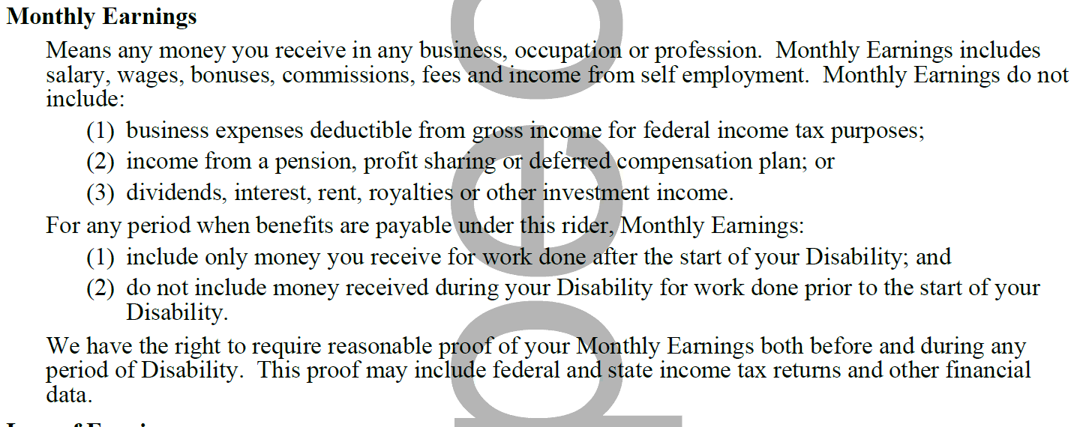
Individual Disability Policies
Should pandemic funds be included as income for CMI?
Sample Earnings Definition
Notes:
Consider
Earnings definition
TD definition
RD definition

Slide 19
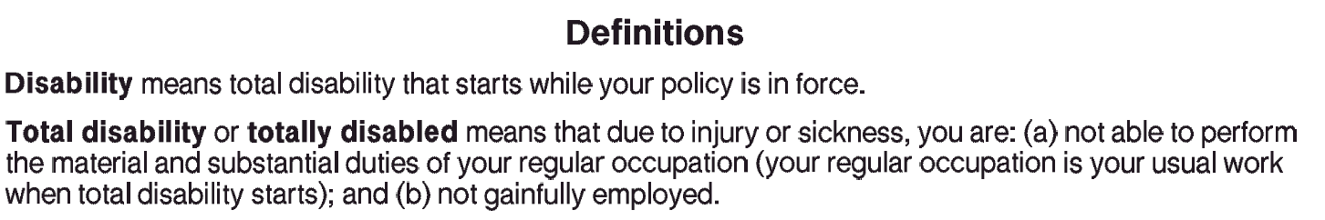
All policies require the loss to be due to disability
Notes:
DUE to injury and sickness.. This may not be true during the covid shut down. Did the impacts covid cause a loss to the business (was the business not able to recover from pandemic)

Slide 20
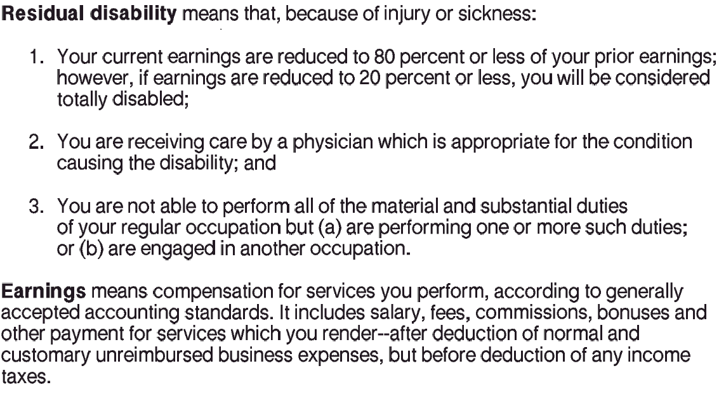
All policies require the loss to be due to disability
Notes:
Due to injury and sickness
20% to qualify and 80% max benefit
GAAS def language not the best

Slide 21
Should we include pandemic funds in current monthly income?
For IDI claims?
For Group claims?
Per policy loss of income needs to be due to disability.
Did pandemic cause the loss or disability?
Argument can be made there is no loss as government stepped in to provide relief for any losses during the pandemic.
Notes:
The real issue for carriers is how to calculate the pre-dis earnings during the pandemic, handle BOE claims and what to include in the Current Earnings calculation and what not!

Slide 22
Bonus Material
“Earnings“ or ”Investment”
Passive vs. Non-Passive

Slide 23
Earnings “or” Investment
How is income (loss) reported on tax return?
Employee (Form W2) – Wages & Employer Pension Contributions
Sole Proprietorship/LLC Schedule C (Form 1040) – Net Profit (Loss)
Partnership/LLP (Form 1065) – Guaranteed Payments & Ordinary Business Income (OBI)
S Corporation/PC (Form 1120S) – Officers Comp (W2) & Ordinary Business income (OBI)
Corporation (Form 1120) – Officers Comp (W2) & Taxable Income before NOL
(Investment Income…Interest, Dividends, Capital Gains (Loss))

Slide 24
Earnings “or” Investment
Passive v Non-Passive Income
(26 U.S. Code § 469 - Passive activity losses and credits limited)
Does the Insured Materially Participate in the business activity?
Establishing Material Participation
Considered “materially” in an activity if meets one of seven participation tests: four-time tests, two long-standing (or “look-back”) tests, or a seventh residual facts and circumstances test (§1.469-5T(a)(1)-(7)).
Tax Rules very complex and provide us guidance when considering if earnings under the policy definitions.

Slide 25
Earnings “or” Investment
How to determine “materially participate” (MP) using any of the seven tests.
An individual materially participates in an activity if they and/or their spouse:
1. Works 500 or more hours in the activity.
2. Does substantially all the work (i.e., more than 70% of the total business hours for the year are performed by the owner). “Substantially all” includes services of nonowner employees.
3. Works 100 hours, and no one else does more.
4. Works 500 hours in all businesses owned. The individual is deemed to materially participate when the activity is a “significant participation activity” (SPA) for the taxable year, and the individual’s aggregate participation in all SPAs during such year exceeds 500 hours.
5. Materially participates in the activity for five of the last 10 years (whether or not consecutive) during the 10 taxable years that immediately precede the taxable year.
6. Participates in a personal service activity with three years of participation. Individual materially
participates in a personal service activity (e.g., accountants, lawyers, doctors, etc.) for any three taxable years (whether or not consecutive) preceding the taxable year.
7. Proves facts and circumstances. Based on all of the facts and circumstances, the individual
participates in the activity on a regular, continuous, and substantial basis during the tax year.

Slide 26
Earnings “or” Investment
Hobby Loss Rules Can Also Help to Determine
if Engaged For Profit and Earnings under the policy.
9 Factors IRS use to Determine Profit Motive

Slide 27
Earnings “or” Investment
IRS factors used to determine profit motive. Whether or not an activity is presumed to be operated for
profit requires an analysis of the facts and circumstances of each case. Neither the Code nor the
Regulations provides an absolute definition. As a result, deciding whether a taxpayer operates an activity
with an actual and honest profit motive typically involves applying the nine nonexclusive factors contained
in §1.183-2(b). These factors are as follows:
1. The manner in which the taxpayer carried on the activity.
2. The expertise of the taxpayer or his or her advisers.
3. The time and effort expended by the taxpayer in carrying on the activity.
4. The expectation that the assets used in the activity may appreciate in value.
5. The success of the taxpayer in carrying on other similar or dissimilar activities.
6. The taxpayer’s history of income or loss with respect to the activity.
7. The amount of occasional profits, if any, which are earned.
8. The financial status of the taxpayer.
9. Elements of personal pleasure or recreation.
No single factor controls and the factors do not have equal weight, meaning the mere fact that the majority
of factors indicate a profit objective exists (or vice versa) is not conclusive. For example, if five factors say
the activity is not for profit, but four are on the profit side, the activity still could be determined to be
engaged in for profit.

Slide 28
Earnings “or” Investment
Some Factors NAWROCKI SMITH Consider to Determine Earnings “or” Investment:
How is income reported on tax return?
What is the Insured’s ownership percentage and control of business?
Passive vs Non-Passive on tax return
Is there a For Profit Motive?
Historical Income (Loss) from activity
Insured’s experience, training, education (CV)
Marketing & Promotional Material
Website – Is the Insured mentioned on website? Bio?
Linked In – Is the business indicated? Consider Descriptions? Business Cards?
Does the Insured have an email account for the business?
Does the Insured have an office/desk at the business location?
Does the Insured have regular business hours at the business?
Does the Insured have time to devote to business when considering other possible occupations?
The Insured’s descriptions of his involvement, duties, activities and responsibilities related to the business operations.

Slide 29
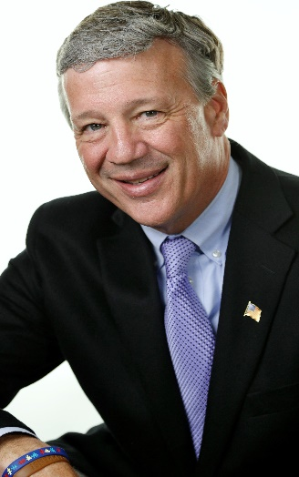


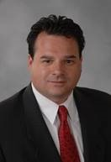
THANK
YOU
Ernest Patrick Smith CPA/ABV/CFF, CVA, CEPA
(631) 756-9500 x 223 C: (516) 659-5151
epsmith@ns.cpa
John Hoffman, CPA/CFF/CITP
(631) 756-9500 x 228 C: (631) 834-2695
jhoffman@ns.cpa

